Slide 1
Presentation brief for MCT’s
Title of presentation | Perform Integrated Machine Learning Processes in Azure Synapse Analytics
Presentation\Lab length | Presentation: 10 – 15 minutes Lab: 40 – 50 minutes
Audience | Data Scientists, Data Professionals, Data Architects, Business Intelligence Professionals, Developers
Purpose | Understand how Azure Machine Learning Service integrates with Synapse Analytics You will not teach the student Machine Learning or Data Science as that is in the DP100 certification courses
(think) Student key takeaways | The student should understand the data science process The student should understand how Azure Machine Learning Service integrates with Synapse Analytics The student should know how the PREDICT function can be used
(feel) Student desired mindset | The student may feel overwhelmed by going through data science and machine learning The student should only feel that they only need to understand the integration points in this module
(do) Student outcomes | The student should be able to run a Machine Learning model in Azure Synapse confidently The student should be able to understand the Predict function
More information | For MCT course feedback, visit the Microsoft Official Courseware forum
Notes:
Instructor notes and guidance
This slide is for MCT use only, outlining the aims and objectives of this module.

Slide 2
DP-203T00: Perform Integrated Machine Learning Processes in Azure Synapse Analytics
Notes:
Instructor notes and guidance
In this module, the main goal is to demonstrate how Azure Machine Learning Services integrates with the Apache Spark cluster within Azure Synapse Analytics. It is not the intention to provide exhaustive coverage of data science and machine learning. If the students ask for that, direct them to the DP-100: Microsoft Data Scientist Associate certification. You may want to cover some of the high-level concepts for managing the data science process, as this will tie into some of the screen featured in the slides. You can also call out the T-SQL programming language can be used to work with Machine learning using the PREDICT function, all of this will be explored in the lab
From a certification perspective, this module could be omitted from a course that you teach, or if you wanted to, you could teach module 16 and 17, and then give the students the choice which lab they may prefer to do if you are lacking time.

Slide 3

Agenda
Lesson 01 – Perform Integrated Machine Learning Processes in Azure Synapse Analytics
Notes:
Instructor notes and guidance
This space has been left deliberately blank.

Slide 4
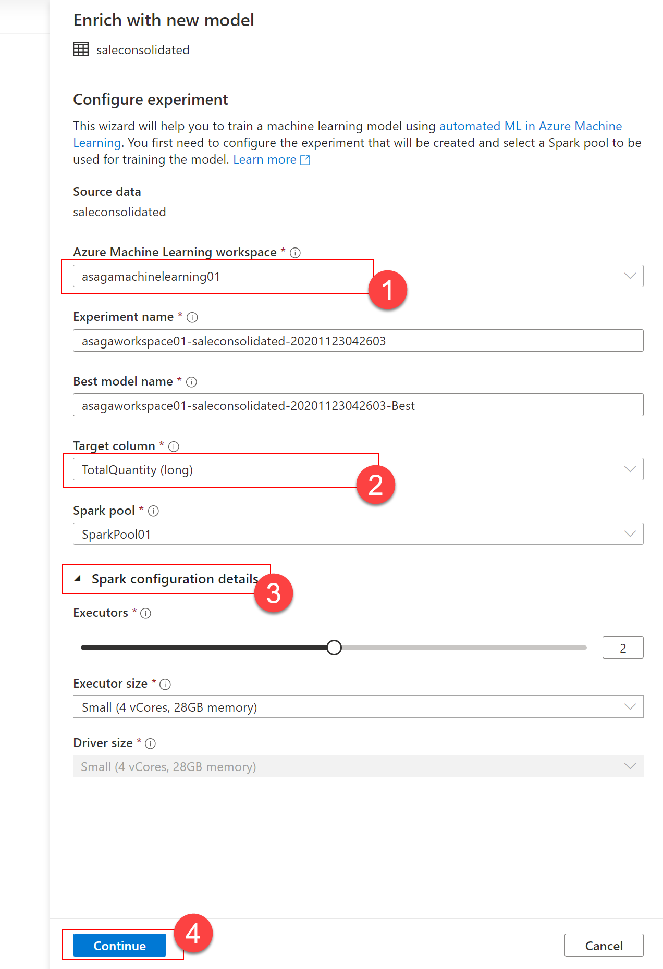
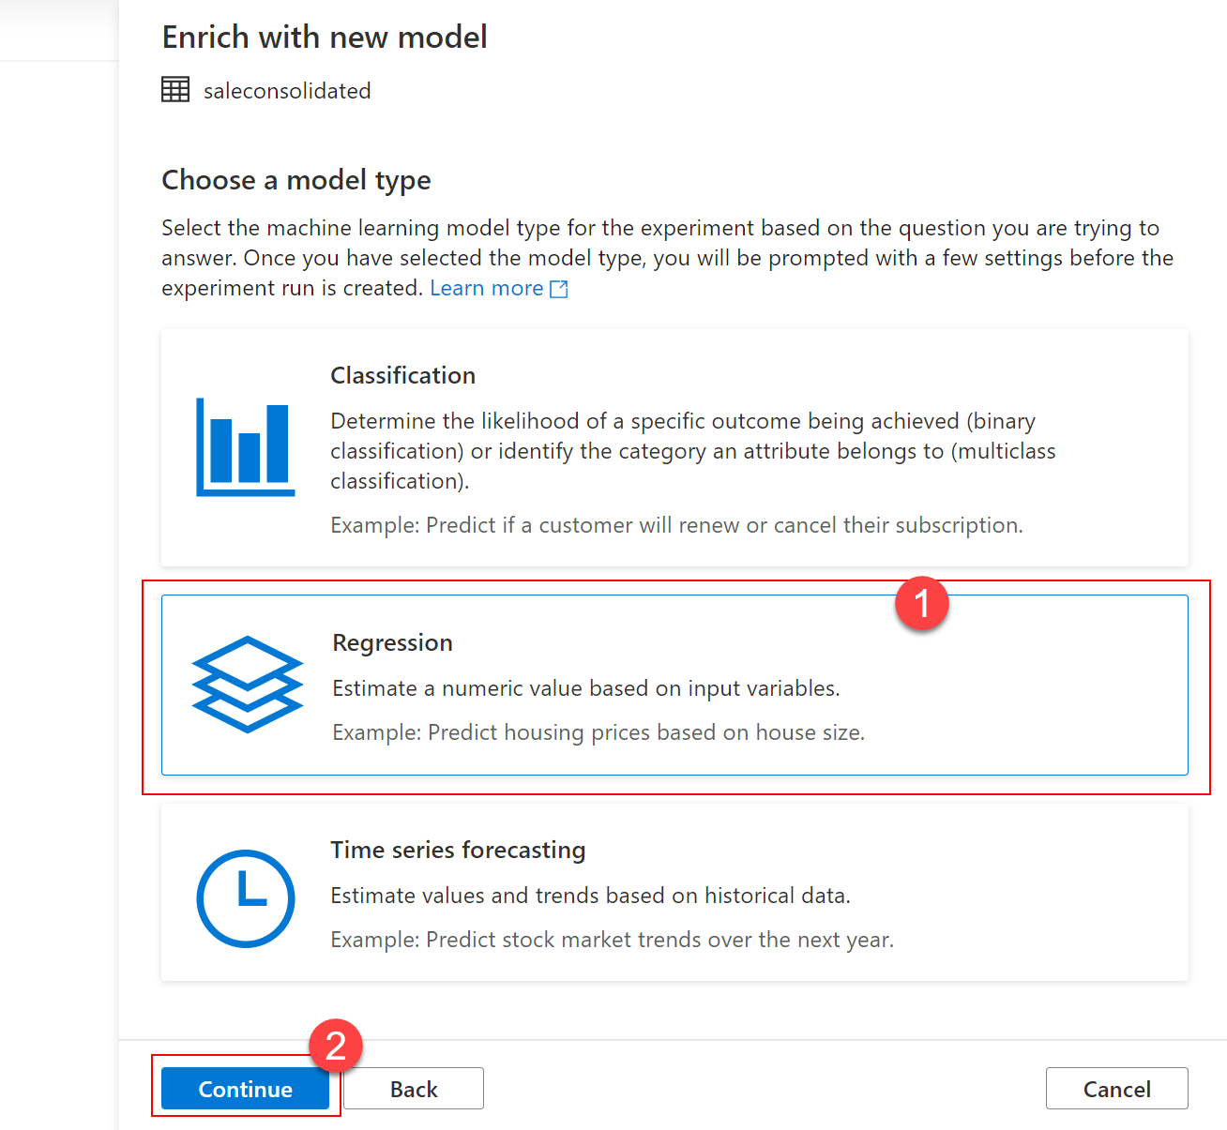
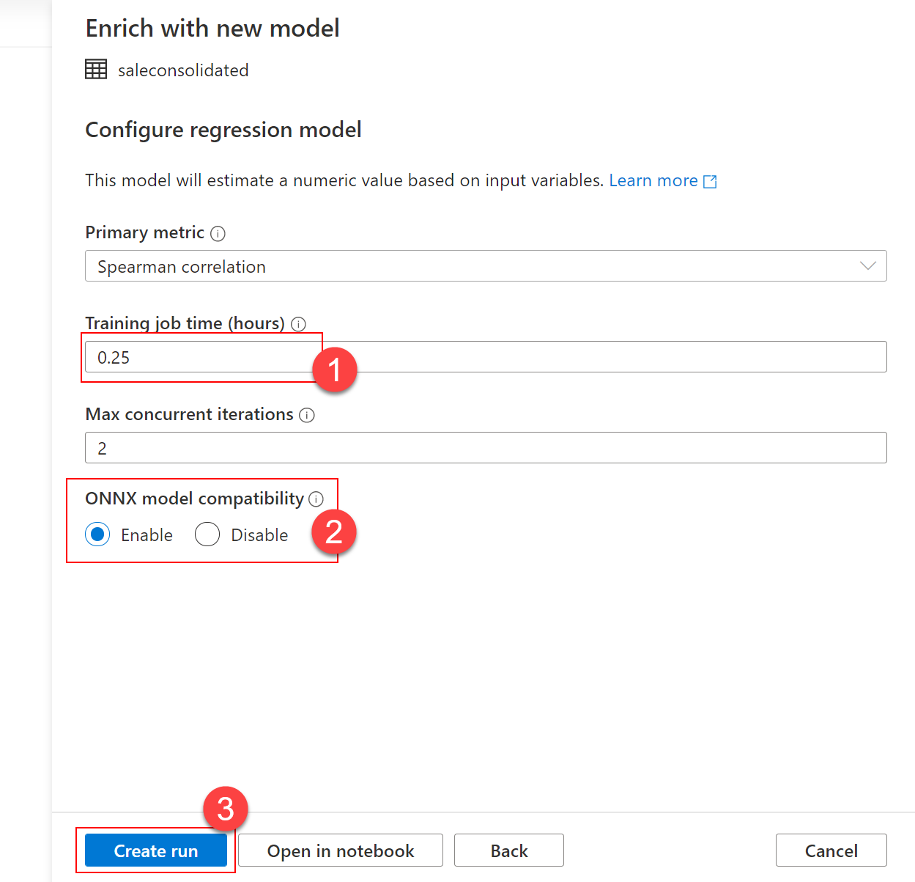
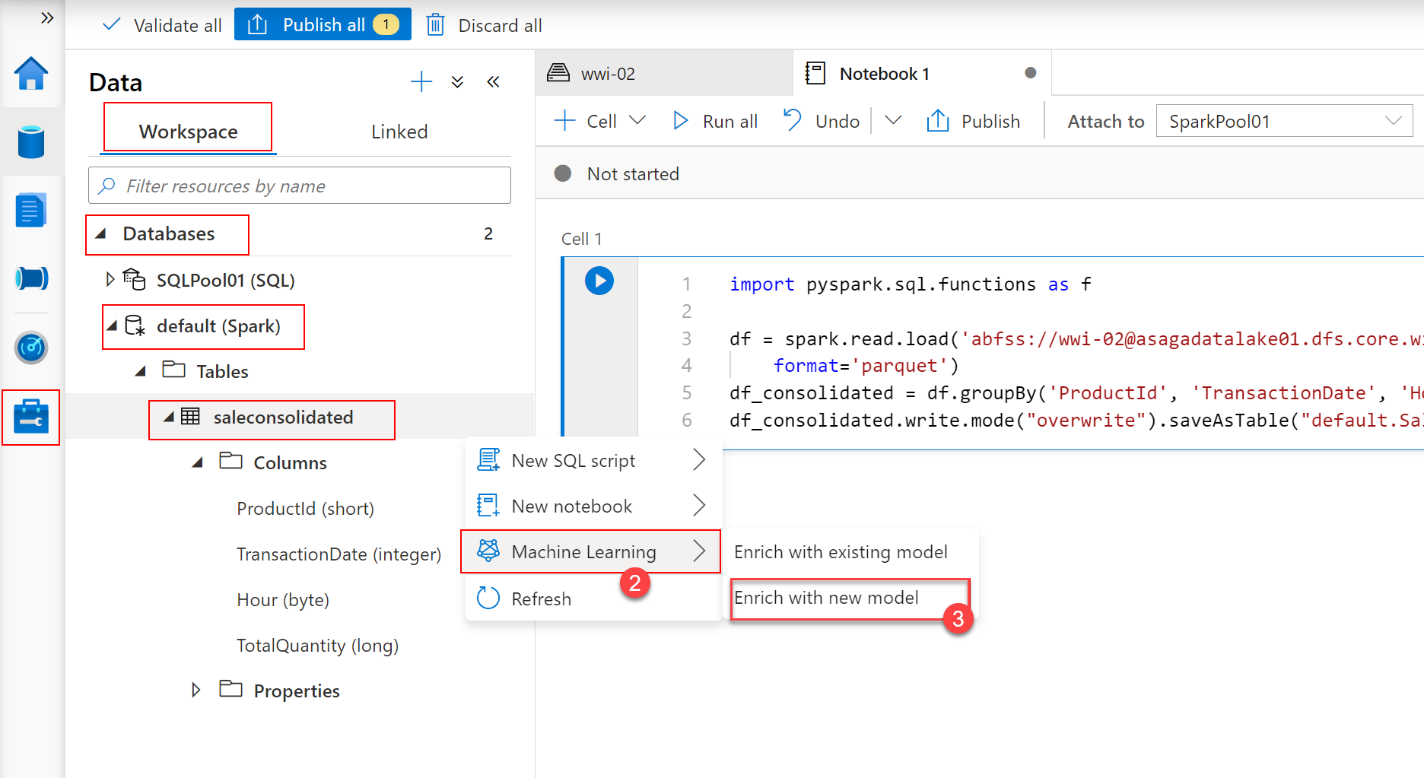
Perform Integrated Machine Learning Processes in Azure Synapse Analytics
Notes:
Talking points
The students should be familiar with the first image shown on this slide if you have already covered Apache Spark pools in Azure Synapse Analytics. Outline to the students that when they configure an experiment, they may need to become familiar with some of these options. The purpose of AutoML is to democratize the machine learning process, so it does simplify the work, but they will need to work with a data scientist to understand the results.
Instructor notes and guidance
This slide is a build slide, and you should become familiar with the order.
Click 1 – Shows you how to access the machine learning integration with Spark. Remember that you first have to create a Spark table with the data first, in this case “saleconsolidated”, from there you can see the Machine Learning menu item (2) with a right click of the table followed by the options. If you click Enrich with new model (3)
Click 2 – This shows the Enrich with new model dialog box where you specifically integrate with the Azure Machine Learning Workspace (1), picking out the experiment name and best model name, and specify the Target (AKA predicted) column (2). You also configure the Spark cluster(3) on which it runs, when you click on Continue(4)
Click 3 – the screen clears
Click 4 - The choose model type screen appears where the user can select which type of AutoML operation to perform, in this case it will be Regression(1) and then when you click on Continue(2)
Click 5 – You can configure the model, in this case it’s a regression model, choosing the method of regression in the primary metric property, the training job time (1), the max concurrent iterations, and whether it will take advantage of ONNX(2). When you click on create run (3) a notification will appear in the Azure portal
Recommended reading for this slide
Use the integrated machine learning process in Azure Synapse Analytics

Slide 5
Review questions
Q01 – What compute target is used when AutoML runs through the Spark pool inside Synapse Analytics?
A01 – Local Compute
Q02 – What can help to make sure AutoML Models support ONNX format?
A02 – Enable ONNX model compatibility on the portal during enrichment model configuration
Q03 – What is correct about T-SQL PREDICT command?
A03 – Generates a predicted value or scores based on a stored model within the confines of the data warehouse.
Notes:
Instructor notes and guidance
This space has been left deliberately blank

Slide 6
Lab: Perform Integrated Machine Learning Processes in Azure Synapse Analytics
Notes:
Instructor notes and guidance
This space has been left deliberately blank

Slide 7
Lab overview
In the lab, the students will explore the integrated, end-to-end Azure Machine Learning and Azure Cognitive Services experience in Azure Synapse Analytics. You will learn how to connect an Azure Synapse Analytics workspace to an Azure Machine Learning workspace using a Linked Service and then trigger an Automated ML experiment that uses data from a Spark table. You will also learn how to use trained models from Azure Machine Learning or Azure Cognitive Services to enrich data in a SQL pool table and then serve prediction results using Power BI.
Lab objectives
After completing this lab, you will be able to:
Perform Integrated Machine Learning Processes in Azure Synapse Analytics
Notes:
Instructor notes and guidance
In exercise 1 of this lab, the student will be in familiar territory as they create and configure an Azure Machine Learning linked service in Synapse Studio that enables them to explore the Azure Machine Learning integration features in Azure Synapse.
In exercise 2, the student you will create an Auto ML experiment within Azure Synapse Analytics, trigger the execution of it and view its progress in Azure Machine learning studio.
In exercise 3, the students see the results of their work as they use the trained models to perform predictions on data using Azure Machine Learning Services, and then they view an example of using it with Azure Cognitive Services. They will also learn how they can integrate this into a pipeline to automate the work.
In exercise 4, allows the students to view the prediction results in a Power BI report, and trigger the forecast pipeline with new input data and view the updated quantities in the Power BI report.

Slide 8












Lab 17 Overview
asacosmosdb<unique_suffix>
CosmosDB
Campaign Info
Azure Databricks
asagadatalake<unique_suffix>
Cluster
Azure Data Lake
wwi-02
asagamachinelearning01<suffix>
Machine
Learning
SalesConsolidated
(parquet)
dp203sql<unique_suffix>
SourceDB
Azure Synapse Analytics
Dedicated SQL Pool (SQLPool1)
Built-In Serverless SQL Pool
Apache Spark pool
Pipelines and Dataflows
Power BI
asagaworkspace<unique_suffix>
Notes:
This slide is an optional slide that you can use to show a high level overview of the technologies used in the lab.
In the lab, the students will explore the integrated, end-to-end Azure Machine Learning and Azure Cognitive Services experience in Azure Synapse Analytics. You will learn how to connect an Azure Synapse Analytics workspace to an Azure Machine Learning workspace using a Linked Service and then trigger an Automated ML experiment that uses data from a Spark table. You will also learn how to use trained models from Azure Machine Learning or Azure Cognitive Services to enrich data in a SQL pool table and then serve prediction results using Power BI.

Slide 9
Lab review
Question 1 – How does Azure Synapse Analytics linked service authenticates with Azure Machine Learning?
Question 2 – Where do you view the experiment details for the experiments that you run?
Question 3 – What type of Cognitive Service can be used with an Azure Synapse Spark table?
Question 4 – Do you see your organization making use of this feature?
Notes:
Answers
Question 1 – By using a service principal based on an Azure Active Directory application
Question 2 – You need to go to the Azure Machine Learning workspace to start the Azure Machine Learning Studio to view the AutoML experiments
Question 3 – The Text Analytics – Sentiment Analysis Cognitive Service can be used with an Azure Synapse Spark table
Question 4 – Open ended answer

Slide 10
Module summary
In this module, you have learned about:
Integrate data from Notebooks with Azure Data Factory or Azure Synapse Pipelines
Next steps
After the course, if you want to learn more about Machine Learning, review the [Microsoft Data Science Associate Certification] for detailed information.
Notes:
Instructor notes and guidance
The next steps is suggested post course learning materials to reinforce what they have learned in the module.

Slide 11
Closing slide
Notes:
Instructor notes and guidance
This space has been left deliberately blank

